Slide 1
End to End Speech Recognition System in Hindi Language
AI Hackathon 2019
Stage II
Team Registration ID - AIH19T-0228
Pradeep, Exl Service, Pradeep129690@exlservice.com
Vikram Jain, Exl Service, Vikram.jain@exlservice.com
Pushpendra Dahiya, EXL Service, Pushpendra.Dahiya@exlservice.com
Abhigyan Raman, Exl Service, Abhigyan.Raman@exlservice.com
Vivek Sahu, Exl Service, Vivek.Sahu@exlservice.com

Slide 2

Outline
Part I: Related work
Part II: Data Understanding
Part III: State of the art
Part IV: Experimental evaluation

Slide 3
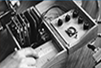
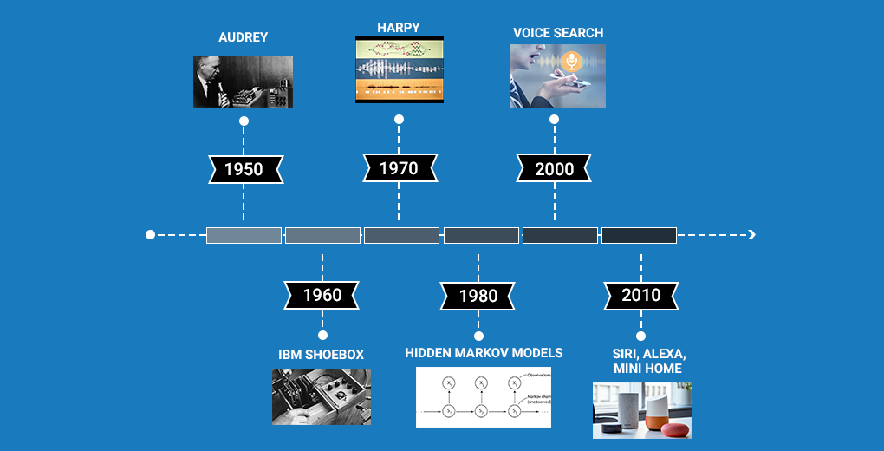


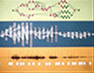

Part I: Related works
1950
1970
2000
IBM SHOEBOX
HIDDEN MARKOV MODELS
SIRI, ALEXA, MINI HOME
AUDREY
HARPY
VOICE SEARCH
1960
1980
2010
1950 DTW (time series) based Speech to text conversion started
HMM based gains momentum in 1980s
2000 – Neural Networks makes entry
2010 – HMM+ NN based models gaining momentum

Slide 4
Part II: Data Understanding
Training Dataset – 20000 Samples
Number of Corrupt Samples – 1
Dataset break-up: Train, Validation and Test dataset into 18904, 995 and 100 samples respectively.
Module added: At preprocessing stage building a csv file containing the path to the wave file and its corresponding transcript and size of .WAV file. Used UTF-8sig Encoding for removing noise as Python 2.x was supported in cluster instead of Python 3.x
No external vocabulary for Hindi language used, extracted all the unique keywords from the training data itself so that even if some unidentified character is present in the dataset it is encoded to some label/class. Our vocabulary contains 96 Characters.

Slide 5
Part III: State of the art End to end speech recognition (SR) in Hindi – solution work Flow
SR Model Training
Training Data – Audio.wav files and Transcript.txt files
Data Preprocessing
(combining wav file with transcript from txt file)
Spectrogram from audio
(Extract Feature rich spectrogram from audio files)
DNN based Acoustic Model (Extract Feature Sequence & Prediction)
End to End SR Model
Preprocessing –
Removal of corrupt files
Changing the format of text to UTF-8-sig
Vocabulary created for the target characters.
Spectrogram –
Windowing
Mel scale log spectrogram
Normalization
Model Description –
Multi Layered CNN + RNN Model
CTC loss function
SR Model Evaluation
Test Data – Audio.wav file
Preprocessing
(Checking the data file, Spectrogram creation from audio file)
End to End SR Model
Decoder
Text Output on UI
Future Work
Output Characters from SR Model
NLP Base Language Model For Hindi Text
Beam Search Decoder with Language Model Re-scoring
Edit Distance Based Misspelling Output
errors correction

Slide 6
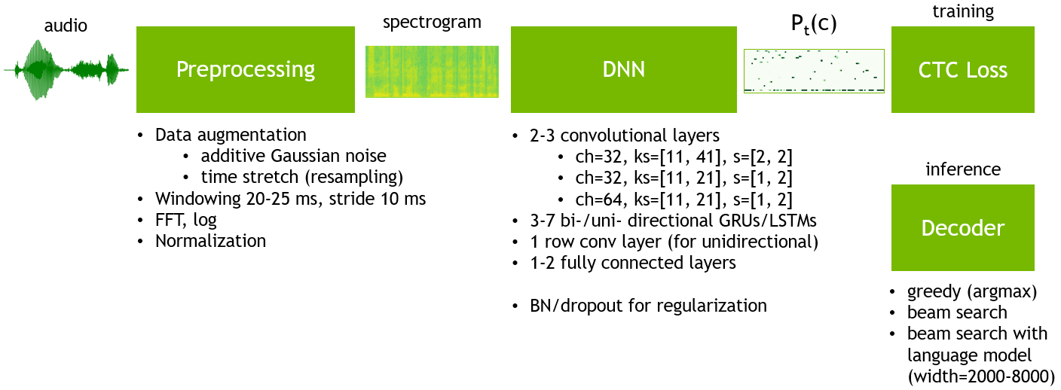
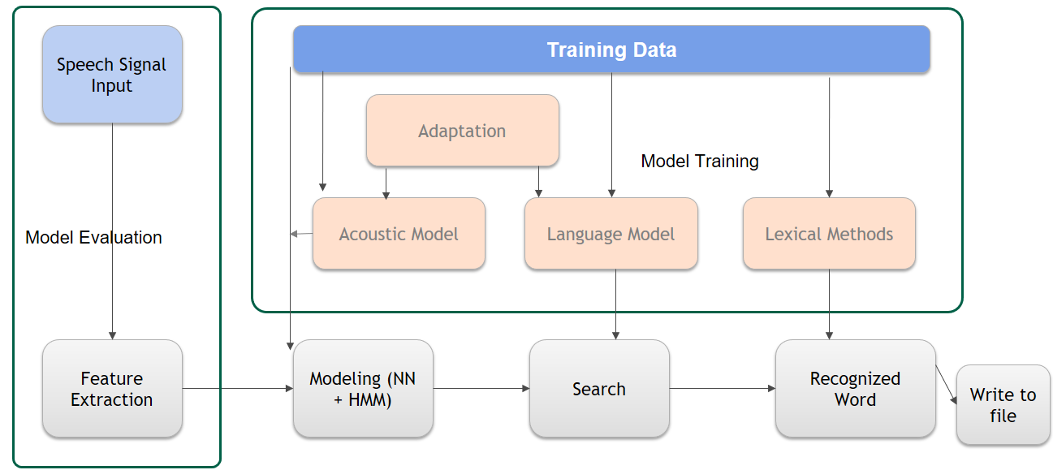
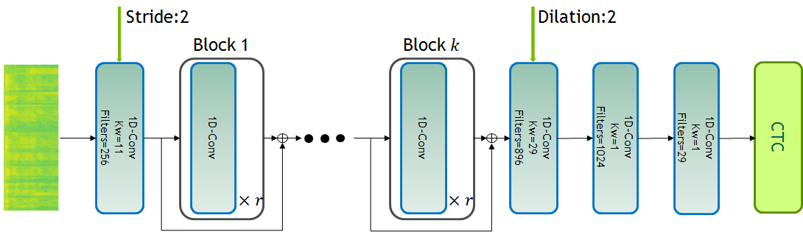
Part III: State of the art Model Approaches
DEEP SPEECH
CUSTOM MODEL
JASPER

Slide 7
Part II: Data Understanding Model Approaches
Conv 2D
–
11
X
41
Conv 2D
–
11
X
21
Conv 2D
–
11
X
21
FC-1
GRU - 1
Conv 1D
–
8
CTC
देवनागरी
I
NPUT
Deep Speech (Small)
32 Ch
64 Ch
96 Ch
256 Hidden Units
256 Cell Dim
Conv 2D
–
11
X
41
Conv 2D
–
11
X
21
Conv 2D
–
11
X
21
GRU - 1
GRU - 2
GRU - 3
Conv 1D
–
8
FC-1
CTC
देवनागरी
Deep Speech(Big)
I
NPUT
Context Vector
32 Ch
64 Ch
96 Ch
1024 Cell Dim
1024 Cell Dim
1024 Cell Dim
2048 Hidden Dims
Attention
Decoder
I
NPUT
CTC
देवनागरी
Listen-Attend-Spell
Conv 1D – 11
Conv 1D – 11
Conv 1D – 11
Conv 1D – 11
Conv 1D – 11
LSTM
256 Ch
256 Ch
384 Ch
512 Ch
768 Ch
512 Cell Dim
GRU - Gated Recurrent Unit
FC - Fully Connected
LSTM -Long Short Term Memory
Encoder

Slide 8
Part III: State of the art
 | Model 1 | Model 2 | Model 3 | Model 4 | Model 5
Model Name | DeepSpeech2(Small) | DeepSpeech2(Big) | Jasper | Listen, Attend and Spell | Our_CustomModel
Methodology | CNN + RNN | CNN + RNN | CNN | RNN + ATTENTION + CTC | HMM + RNN
Reference | https://nvidia.github.io/OpenSeq2Seq/html/index.html | https://nvidia.github.io/OpenSeq2Seq/html/index.html | https://jasperproject.github.io/ | https://nvidia.github.io/OpenSeq2Seq/html/index.html | Tensorflow research model base for signal processing https://github.com/tensorflow/models
Salient Features | Converged relatively faster We are able to train a fairly good model for the dataset provided | Large Network Model Converged relatively faster | CNN only architecture Jasper constitutes of very deep CNN layers Number of channels going up to 1024 for final layer. | Performance improvement in terms of convergence pattern Performance improvement in terms of loss values | Model creation using Python api of HMM Fitting to HMM and decoding RNN based decoding output
Disadvantage |  | Adds unnecessary complexity for smaller data set | Model didn’t converge much further even after fairly large number of epochs | Not giving good results without Language Model. Throwing repeated chars. | Slow in performance Crashes on large sentences Cannot compile on 2.x Python version
Noise Removal | Python 3.X version to 2.x UTF-8sig Encoding used for removing noise | Python 3.X version to 2.x UTF-8sig Encoding used for removing noise | Python 3.X version to 2.x UTF-8sig Encoding used for removing noise | Python 3.X version to 2.x UTF-8sig Encoding used for removing noise

Slide 9
Part IV: Experimental evaluation
Experimental Evaluation
Model Number | Model 1 | Model 2 | Model 3 | Model 4 | Model 5
Model Name | DeepSpeech2(Small) | DeepSpeech2(Big) | Jasper | Listen, Attend and Spell | Our_CustomModel
Differentiator | Small Size model with good performance Tuning CNN model Trained for 500 epochs Saved 5 best checkpoints till the latest step for future retraining | Increased the network size and tweaked the batch size for better Performance Model Tuning for different spectrograph heat maps Fine Tuning CNN model Trained for 500 epochs Saved 5 best checkpoints till the latest step | Model Tuning for difference heat maps Tuning CNN model Trained for 500 epochs Saved 5 best checkpoints till the latest step | Attention based model so minimum context loss | Good performance Trained for 100 epochs AutoSaving best check point and starting from last checkpoint saved for future retraining
Samples Trained | 18904 | 18904 | 18904 | 18904 | 10000
Average Word Error Rate on 100 samples | 0.638 | Eval in Progress | Training not completed | 7.34 | 0.15
Model Rating | 1 | 2 | 4 | 3 | Custom model trained on a totally different dataset, hence not rated
Future plan | Language Model Performance optimization | Synthetic Data Generators |  | Beam Search Tuning Language Model | Training on large dataset Fine tune RNN

Slide 10
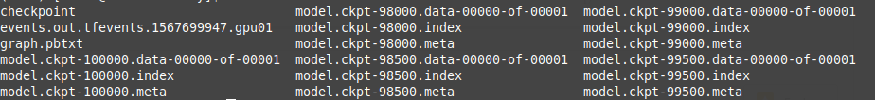

GPU Utilization
We trained all the model for 500 epochs on a single GPU. Also our model uses Cuda-RNN implementation for faster training of RNN layers. This flag should be turned off if the inference is to be run on CPU.
Average time per step(to process single batch) during training time was around 0.297 sec for DeepSpeech2 (small).
We were saving 5 best checkpoints till the latest step
Average objects per second: 18392.405

Slide 11
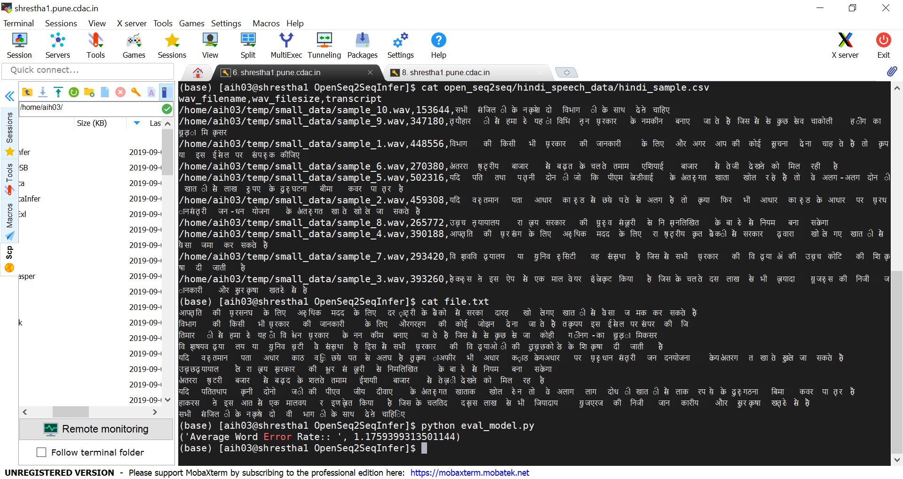
Output on Cluster – For Initial 10 .Wav files

Slide 12
Solution Advantages
End to End Speech Recognition System in Hindi Language
Advantages of above approach set:
Speaker independent model – Only costly enterprise solution supporting which is out of common man reach.
Ability to recognize connected words (minimum pause techniques). We are supporting 10ms pause for hackathon.
System will be able to classify very-large vocabulary – only costly enterprise solution supporting which is out of common man reach.
The system acquires speech at real time through a microphone and processes the sampled speech to identify the uttered text. The recognized text can be stored in a file.
As we are using hybrid model, word recognition probability is very high.
Multiple models trained(including open source based solution – modified for HINDI Speech To Text Translation) to do comparative analysis and select the best model.

Slide 13
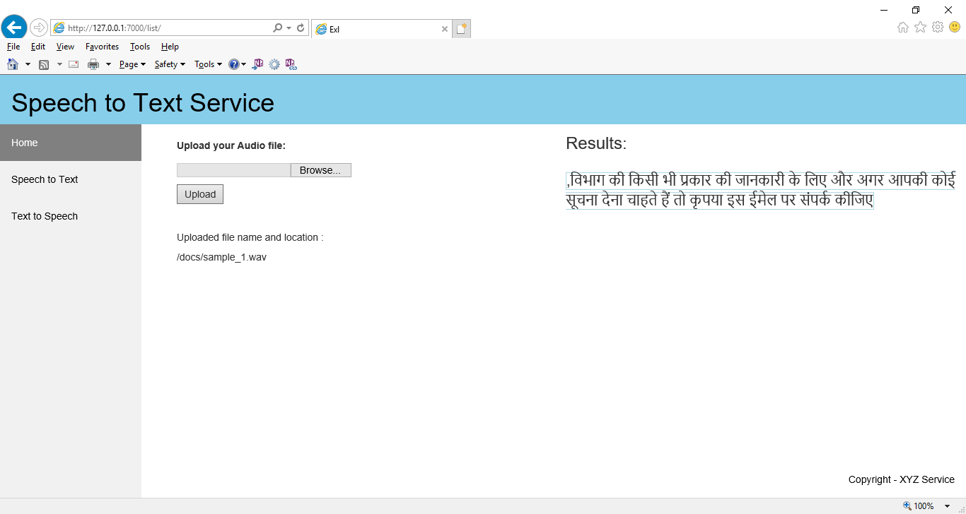
Output on UI – Upload .WaV File and hit Process

Slide 14
How to reproduce the result
Please refer requirements.txt for packages required for model execution
Please refer read me for reproduction steps
*** Please use WordPad to view the above two files

Slide 15
Summary
Model built on top of open source: OpenSeq2Seq. It supports 3.x python version but due cluster environment Supports only Python 2.x so enhanced the code for 2.x python version, compatibility.
Exception handling mechanism added to figure out corrupt .wav files
Code adjusted for Hindi Character Vocabulary(existing model supports English Vocab on open source)
Model tuning done – for filter size, number of channels
Hindi vocabulary support added
Trained 5 different models – 4 Trained on Cluster {Deep Speech(small), Deep Speech(Big), Jasper, Listen-Attend-Spell} and our custom model (trained on a different sample set).
Model# 1 (DeepSpeech) is the best model out of 4 models trained on cluster. It gives the lowest Average WER = 0.638.
Model# 5 Our custom model is trained on a different sample set is giving even better accuracy than model# 4 but we could not train it on cluster data because of python 3.x version unavailability on cluster but we have put the our custom model on cluster along with the readme so that you guys can test it with any test samples. We have tested it with our personal hindi recorded voice and it is converting it to text with average WER = 0.15. If we train it on 19K samples on cluster it will be the best model.

Slide 16





Summary: Future Directions
Correcting the missing or misplaced characters in output can be handled very well using an external language model using deep learning, n-grams with different window size and edit distance based algorithms for improving the overall model accuracy.
We can even fine-tune existing pre-trained Hindi model on our data to achieve further performance/accuracy improvements over those standard language models.
The next step in optimizing of Network performance vs runtime could be Mixed Precision training where we can train at float32 precision but save the network checkpoints and do inference step at float16 precision for low memory usage and much faster (2x-6x improvement) inference time performance.
Synthetic data generator to automatically generate more samples
Train our custom model (HMM+RNN) on 18904 Samples. It must give the best Speech2Text conversion results.
Create mobile app that can convert speech to text in real time.

Slide 17
Thank You!
AI Hackathon 2019

